Slide 1

ECEN 3593-001 Computer Organization
Lecture #26
22 March 2021

Slide 2


Class Announcements
MidTerm grading has been completed
Class Project – Phase 7
Chapter 1

Slide 3
Pause Week
This week is Pause Week
Feel free to take a break, but lectures will continue
This may be a good time to catch up if you are behind on the project
I will hold Zoom OH today from 2:00 to 3:00 - https://cuboulder.zoom.us/j/4317981384

Slide 4
MidTerm feedback
All the MidTerms have been graded, and you should have access to your questions / scores (but not answers)
Grades:
High: 98%
Mean: 76%
To earn back credit on questions 1 to 10, you must hand in updated solutions showing your work
You will earn up to 50% of your lost credit back
Due by 10:00 PM on Wednesday, March 24
Must be handwritten, send photo or scan via Slack DM, include YOUR NAME on the sheet
If you submit a photo, make sure it is readable

Slide 5
Class Announcements
Phases 5 and 6 are in the deduction period – 1%/day
Phase 7 is in the deduction period, but due to Pause Week the deduction will be 4% through Friday at 10:00 PM. 4%/day after that.
Phase 8 will be posted by tomorrow evening
Target Date Sunday, April 4 at 10:00 PM
Bonus 1%/day (maximum 7%), deduction 4%/day

Slide 6
Why is Steve so picky?

Slide 7
Why are we doing the project?

Slide 8
What’s up with Steve’s grading system?
Product Financial Model
Loss Due to Slip
Dollars
Profit on Sales
Spending on Development
Time

Slide 9
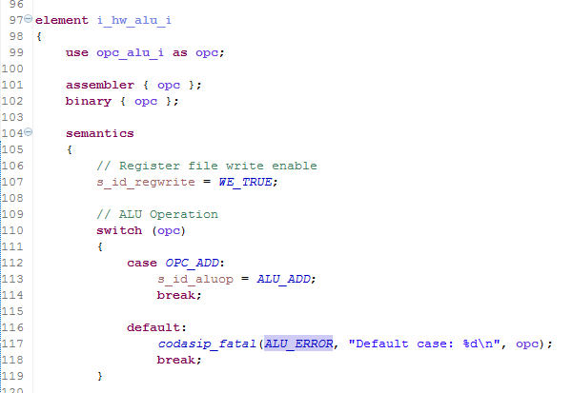
Class Project – Error Messages
Code in ca_decoders.codal
The error code was 19 (0x13).
What instruction is that?
Answer – OPC_ADDI
That isn’t a choice, but it’s decoded here!
Codasip_fatal causes the fatal error print in the gdb(7.4.1) console
The message print occurs in the test console

Slide 10
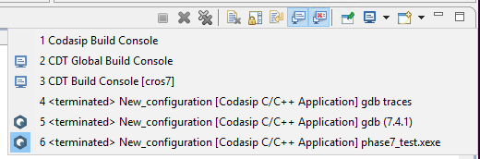
Class Project – Error Messages
If your test just terminates with no errors:
You have a fatal error but Codasip has switched Consoles
Pull down the Console select
Pick the (gdb 7.4.1) Console
You will see the error
The address is correct, and it is out of range
Bad branch/jump – use - -info 11 to debug

Slide 11
Class Project – Error Messages
You may also see the illegal instruction decode error at a valid address
This means you fetched an instruction from memory that the decoder doesn’t recognize
This also happened to some people in Phase 2
You may have the wrong instructions in an element (the opc_xxx value created in isa.codal)
You may have failed to include an element in the set dec statement in the decoder

Slide 12
Class Project – Error Messages
“Broken address in if_code” error
This means that you have tried to fetch an instruction from the Instruction Memory at an address which is not a multiple of 4
This implies that a branch failed, due to a bad branch address
Debug with a BP on ex_output. Look at s_ex_bradd and trace back to see why it is wrong

Slide 13
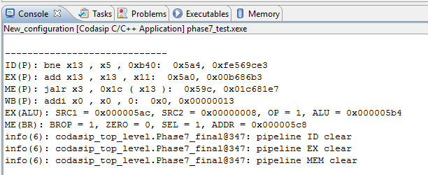
Debugging Branch Errors
Use the - -info 11 command – see the “Debugging Codasip with - -info” document in Canvas
Display with - -info 6,7,11
If you have the wrong console, click the little monitor until you see this
Pipeline display (- -info 6)
Branch display (- -info 11) in ME stage
r_me_brnchop
r_me_zero
s_me_pcsrc
r_me_bradd

Slide 14
Debugging Branch Errors
Indicates the Flush will occur in the next cycle
If you don’t see this, check the creation of the s_STG_clear signals and ca_pipe_control for errors
ALU Display (- -info 7) – useful when a JALR is in the EX stage and produces a bad address in the next cycle

Slide 15
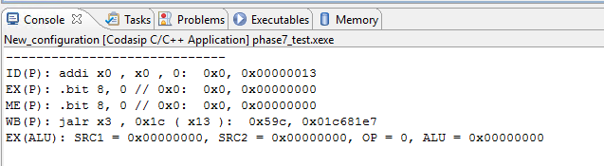
Debugging Branch Errors
Next cycle - display after the Flush
NOP inserted in ID by r_id_clear
EX and ME cleared to all zeroes
JALR not flushed and completes
Why does JALR need to complete? (Poll)

Slide 16
Class Project – Infinite Loop
Test display just sticks with a blue rectangle on an instruction
Use pause (||) button to pause, step to see loop
Use - -info 6 to see what is happening
Virtually always an incorrect branch back to 0

Slide 17
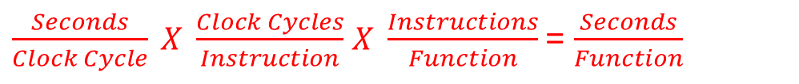
Performance Equation
The only real measure of CPU Performance is execution time
$\frac{Seconds}{Clock Cycle} X \frac{Clock Cycles}{Instruction}$ $X \frac{Instructions}{Function}$= $\frac{Seconds}{Function}$

Slide 18
Definitions: Measuring Execution Time
Elapsed time
Total response time, including all aspects
Processing, I/O, OS overhead, idle time
Determines system performance
CPU time
Time spent processing a given job
Discounts I/O time, other jobs’ shares
Comprises user CPU time and system CPU time
Different programs are affected differently by CPU and system performance

Slide 19
Definitions: Relative Performance
Define Performance = 1/Execution Time
“X is n time faster than Y”
Example: time taken to run a program
10s on A, 15s on B
Execution Time_{B} / Execution Time_{A} = 15s / 10s = 1.5
So A is 1.5 times faster than B

Slide 20
CPI – Clocks Per Instruction
Generally, the operation of digital hardware is governed by a clock
For any instance in time and generally for this course, we will consider the clock frequency constant or stable

Slide 21
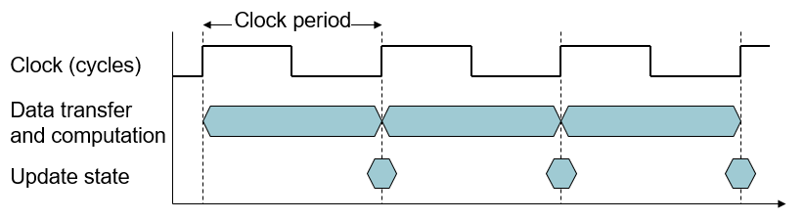
CPI – Clocks Per Instruction
CPU Clocking
Clock frequency (rate): cycles per second
e.g., 4.0GHz = 4000MHz = 4.0×10^9 Hz
Clock period: duration of a clock cycle
e.g., 250ps = 0.25ns = 250×10^(-12) s

Slide 22
CPI – Clocks Per Instruction
Generally, the operation of digital hardware is governed by a clock
The clock frequency can dynamically change
Example: The Ambiq Micro Apollo3 MCU
Application target: Low power/energy systems
How achieved: Advanced peripherals that perform work with the most energy consuming component (the CPU), is turned off (either by removing the clock or removing power)
By default, all peripherals have their clocks turned off, software must enable them, but peripherals may automatically turn their clocks off when an operation is complete
On the fly, the Cortex-M clock can be reconfigured to run at a lower frequency to save energy (48 or 96 MHz)

Slide 23
CPI – Clocks Per Instruction
CPU Time for program execution
Performance improved by
Reducing number of clock cycles
Increasing clock rate
Hardware designer must often trade off clock rate against cycle count

Slide 24
CPI – Clocks Per Instruction
CPU Time Example
Computer A: 2GHz clock, 10s CPU time for program to execute
Designing Computer B
Aim for 6s CPU time for program to execute
Can do faster clock, but causes 1.2 × clock cycles
How fast must Computer B clock be?

Slide 25
Instruction count and CPI
What determines the instruction count for a computer?
ISA
Compiler
What determines cycles per instruction, CPI?
Determined by CPU hardware
If different instructions have different CPI
Average CPI affected by instruction mix

Slide 26
CPI and Cycle Time
Now lets take a look at the same Computer Architecture, same ISA, example
Computer A: Cycle Time = 250ps, CPI = 2.0
Computer B: Cycle Time = 500ps, CPI = 1.2
Which is faster, and by how much?
A is faster…
…by this much

